Slide 1
Create a Service Fabric solution with Visual Studio 2017
In this exercise, you are going to create a new Service Fabric solution using Visual Studio 2017 that will initially include two microservice project types. These microservices will be the Actor Service and the ASP.NET Core web service. Each instance of the reliable actor service will be a separate unit of execution (like a thread) and this will allow the search across each website to occur in parallel. This first portion of the lab will be creating the code for that reliable actor service.

Slide 2
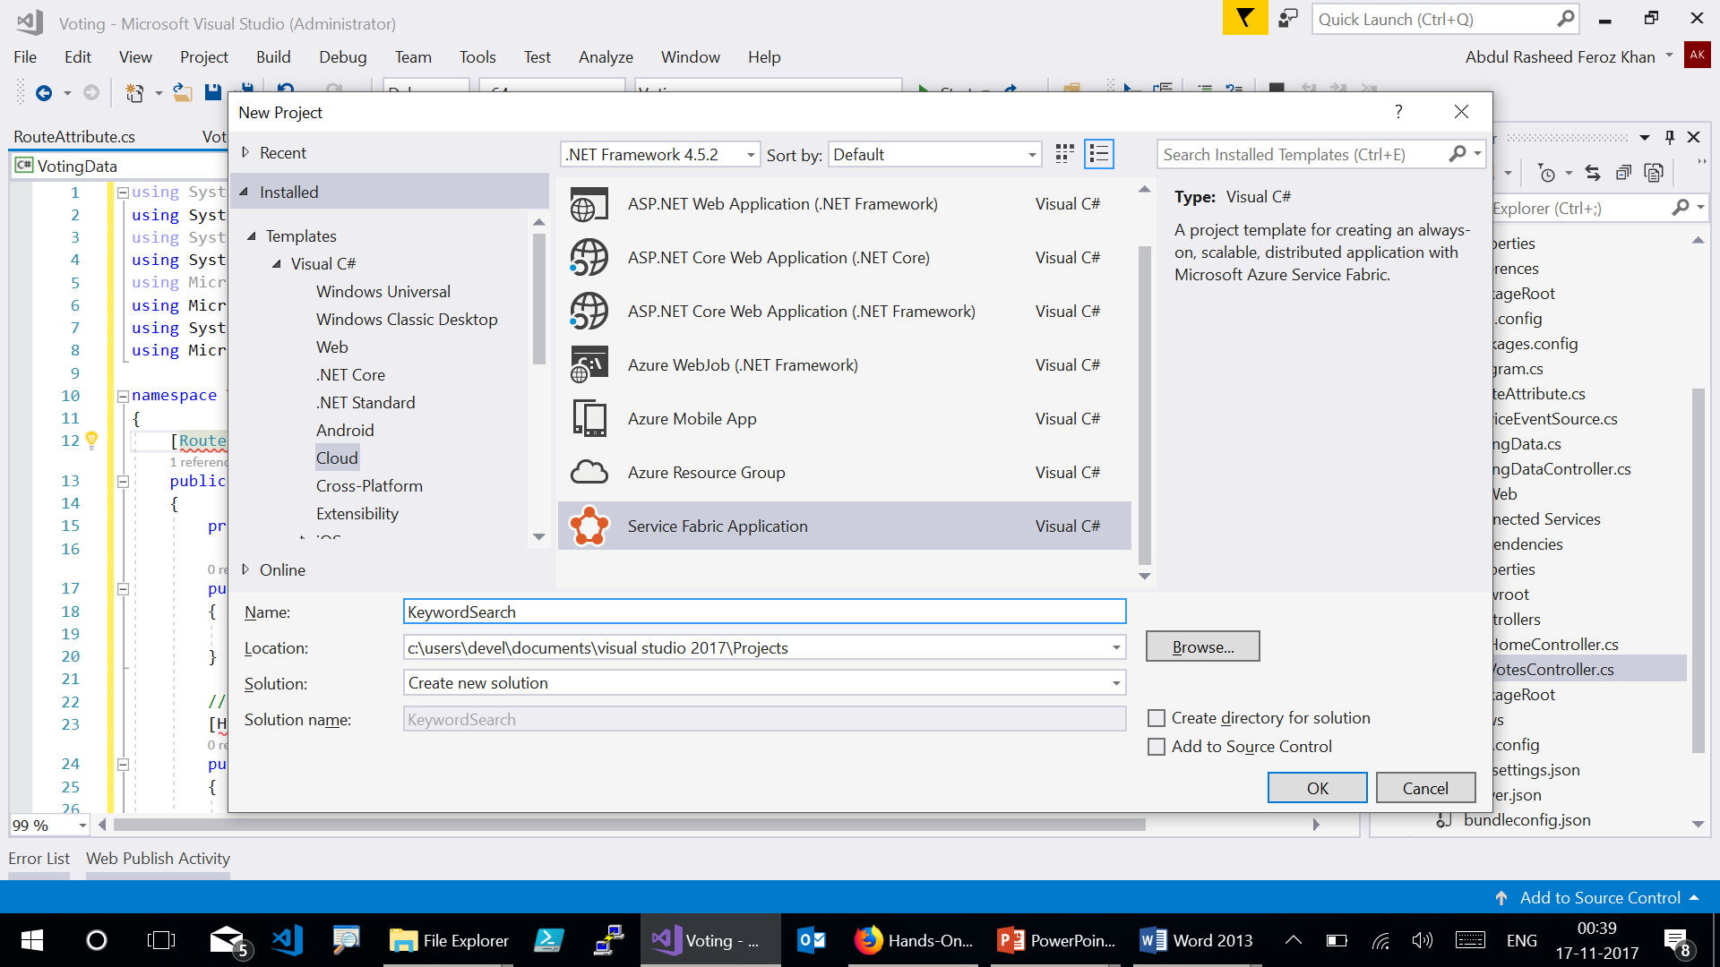
Notes:
Select Actor Service in the next template page.

Slide 3
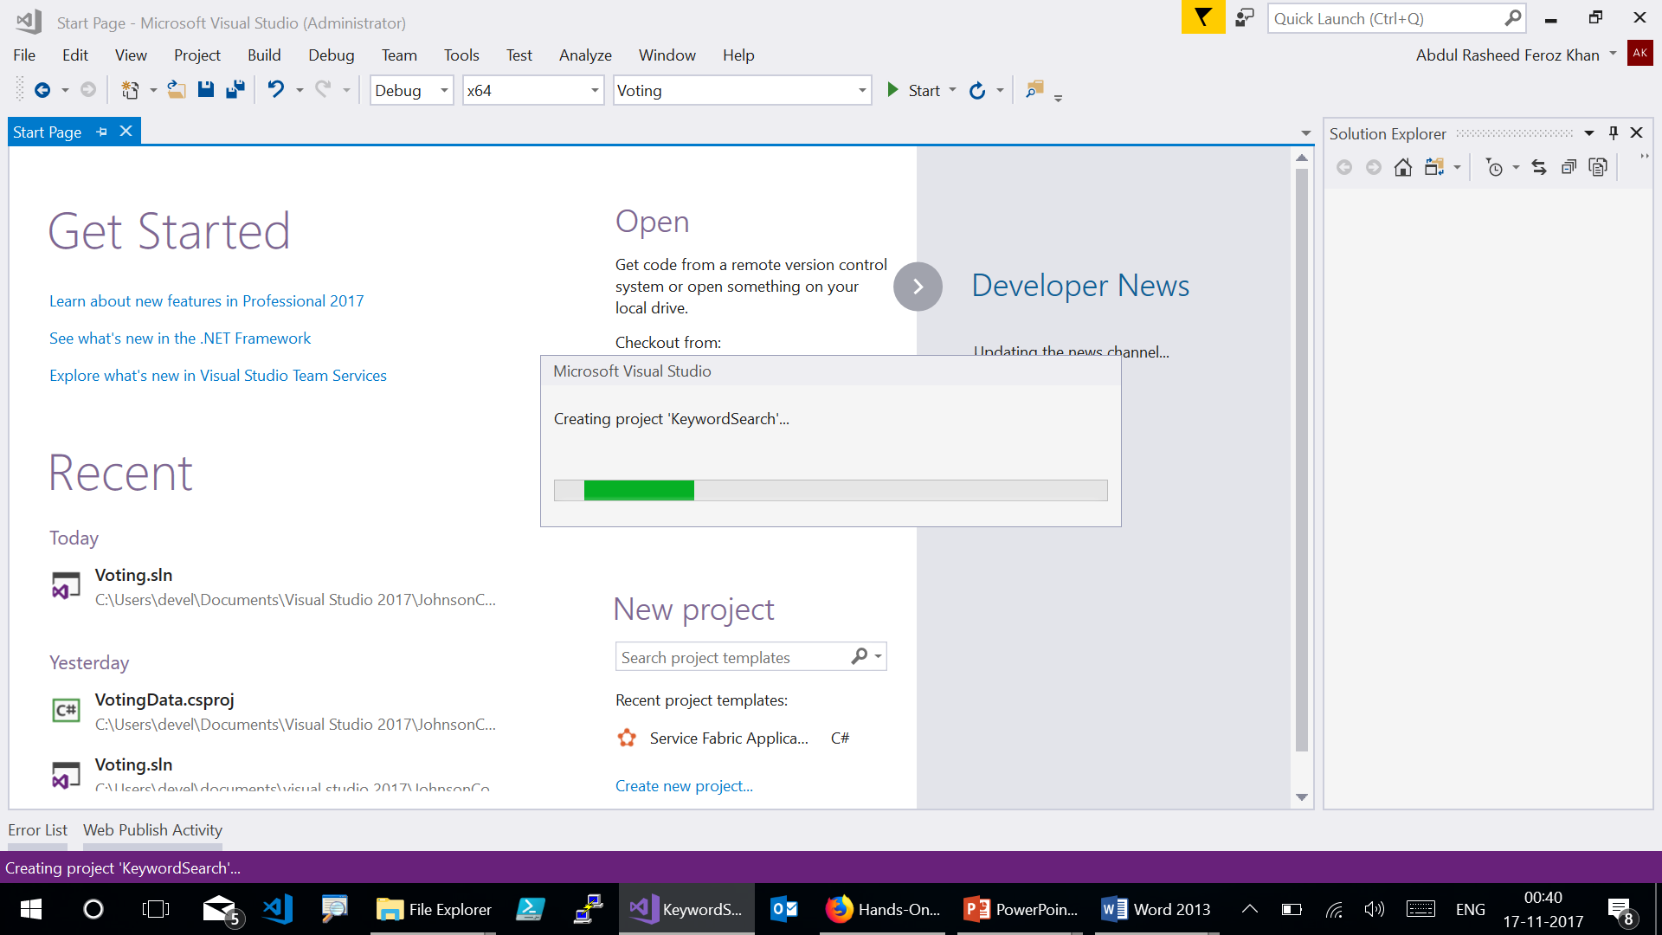

Slide 4
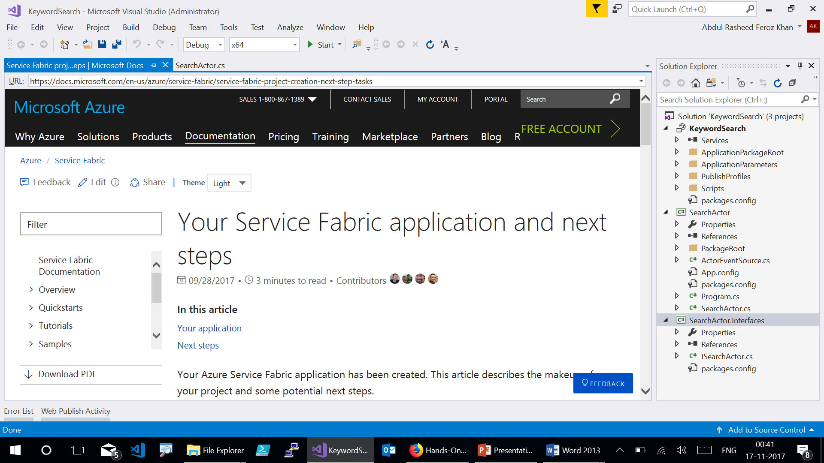
Notes:
Visual Studio will automatically scaffold a new solution for you with three initial projects. It will include a Service Fabric project type (called “KeywordSearch”) that defines the application with all of its microservices, an Actor Service project type (called “SearchActor”), and a Class Library project type (called “SearchActor.Interfaces”) that includes an interface definition for the Actor Service. In the Solution Explorer window, open the SearchActor.cs class file from the SearchActor project and delete the two methods at the bottom: GetCountAsync and SetCountAsync.

Slide 5
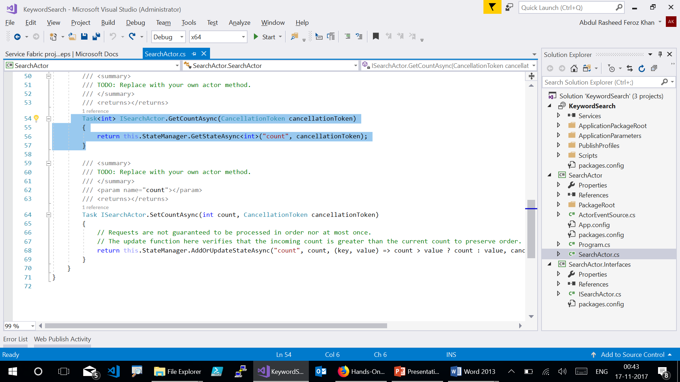

Slide 6
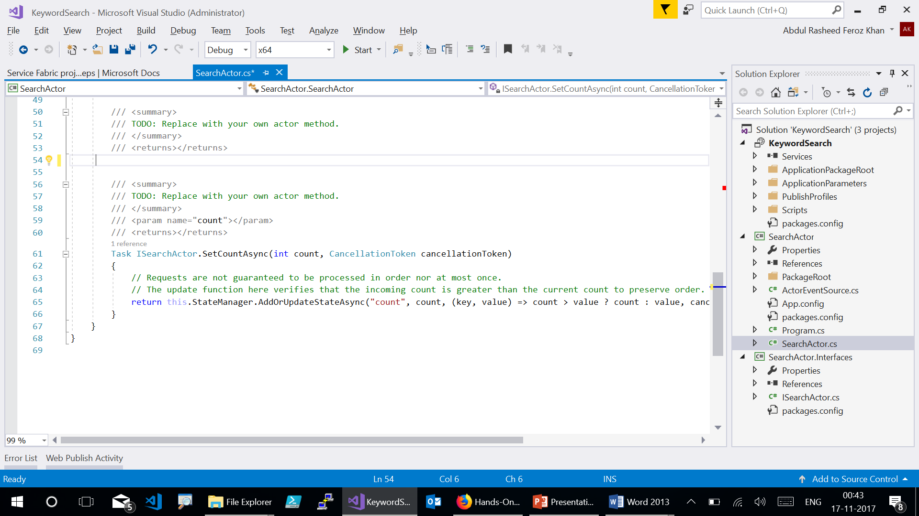

Slide 7
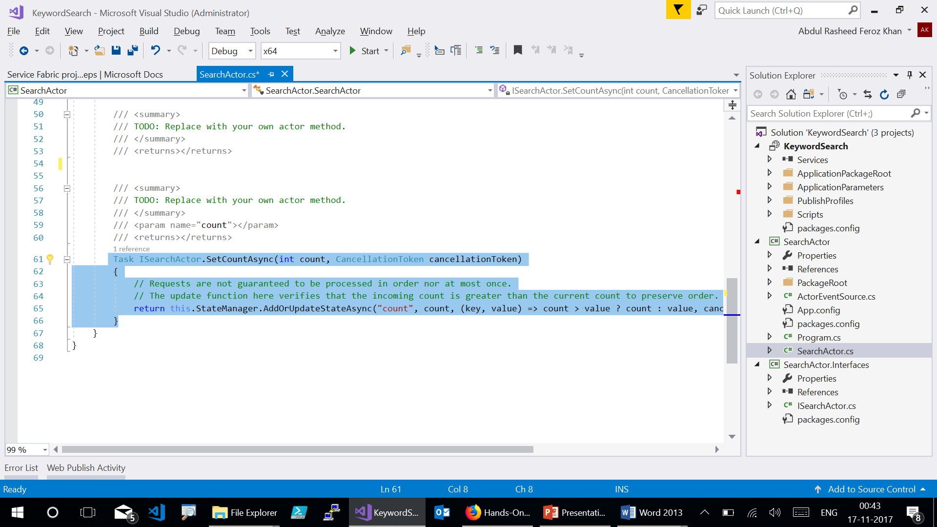

Slide 8
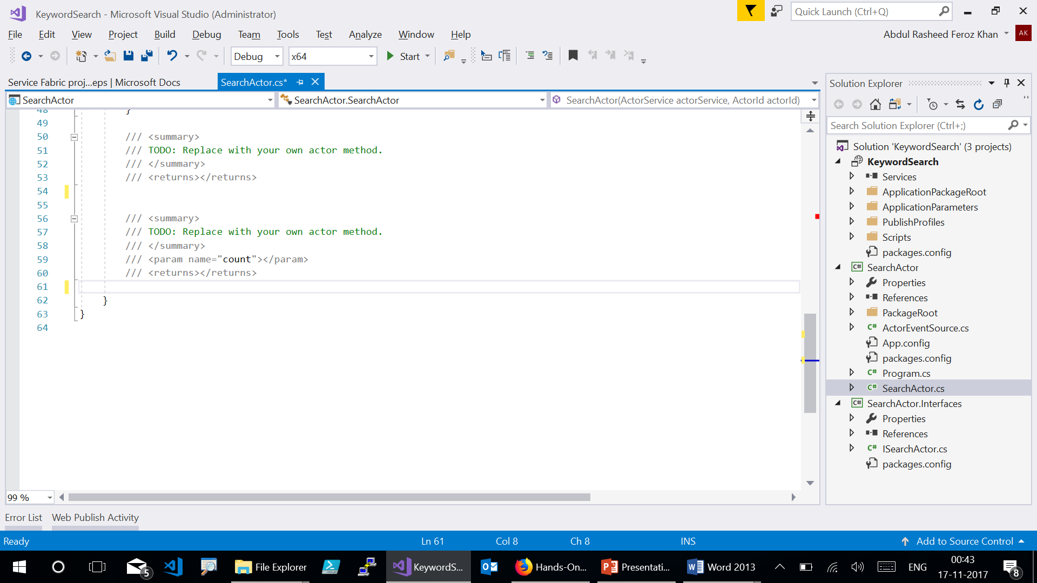

Slide 9
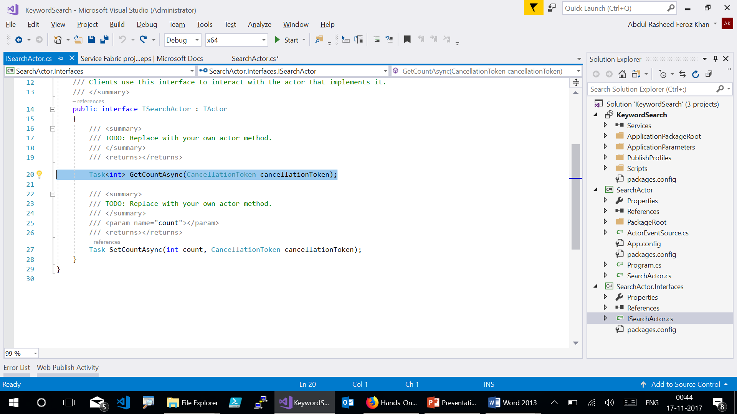

Slide 10
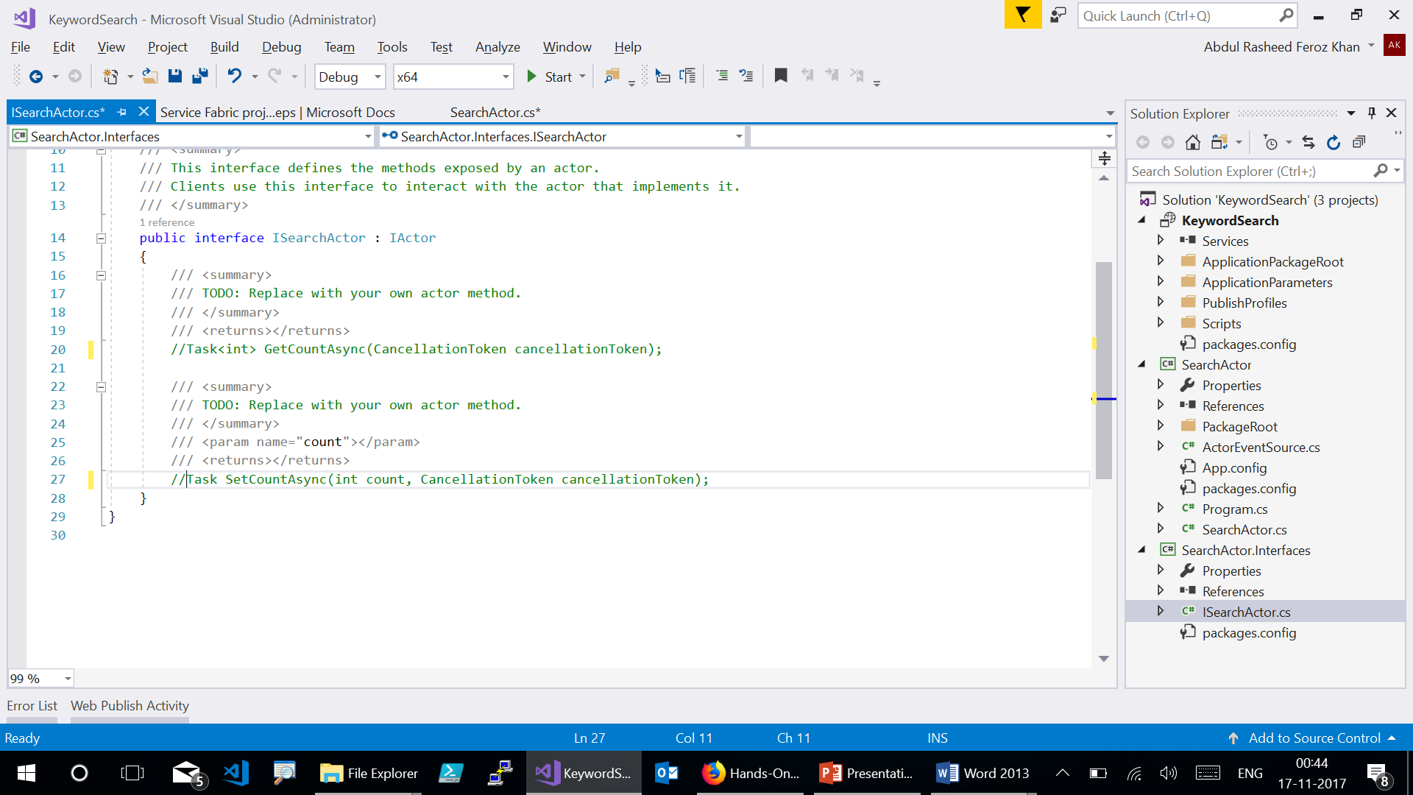

Slide 11
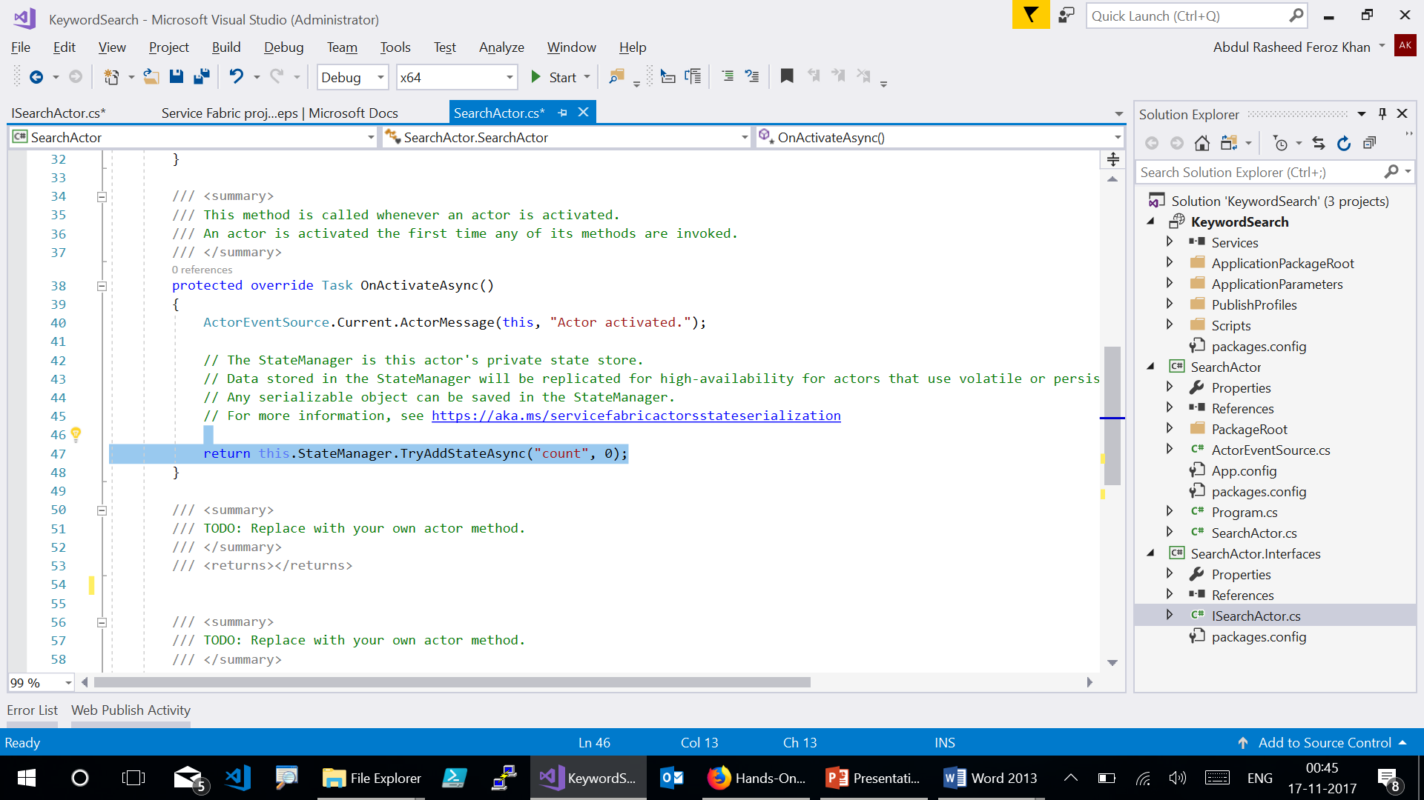
Notes:
Go back to SearchActor.cs and replace the final line of code in the OnActivateAsync method.
return Task.FromResult(true);

Slide 12
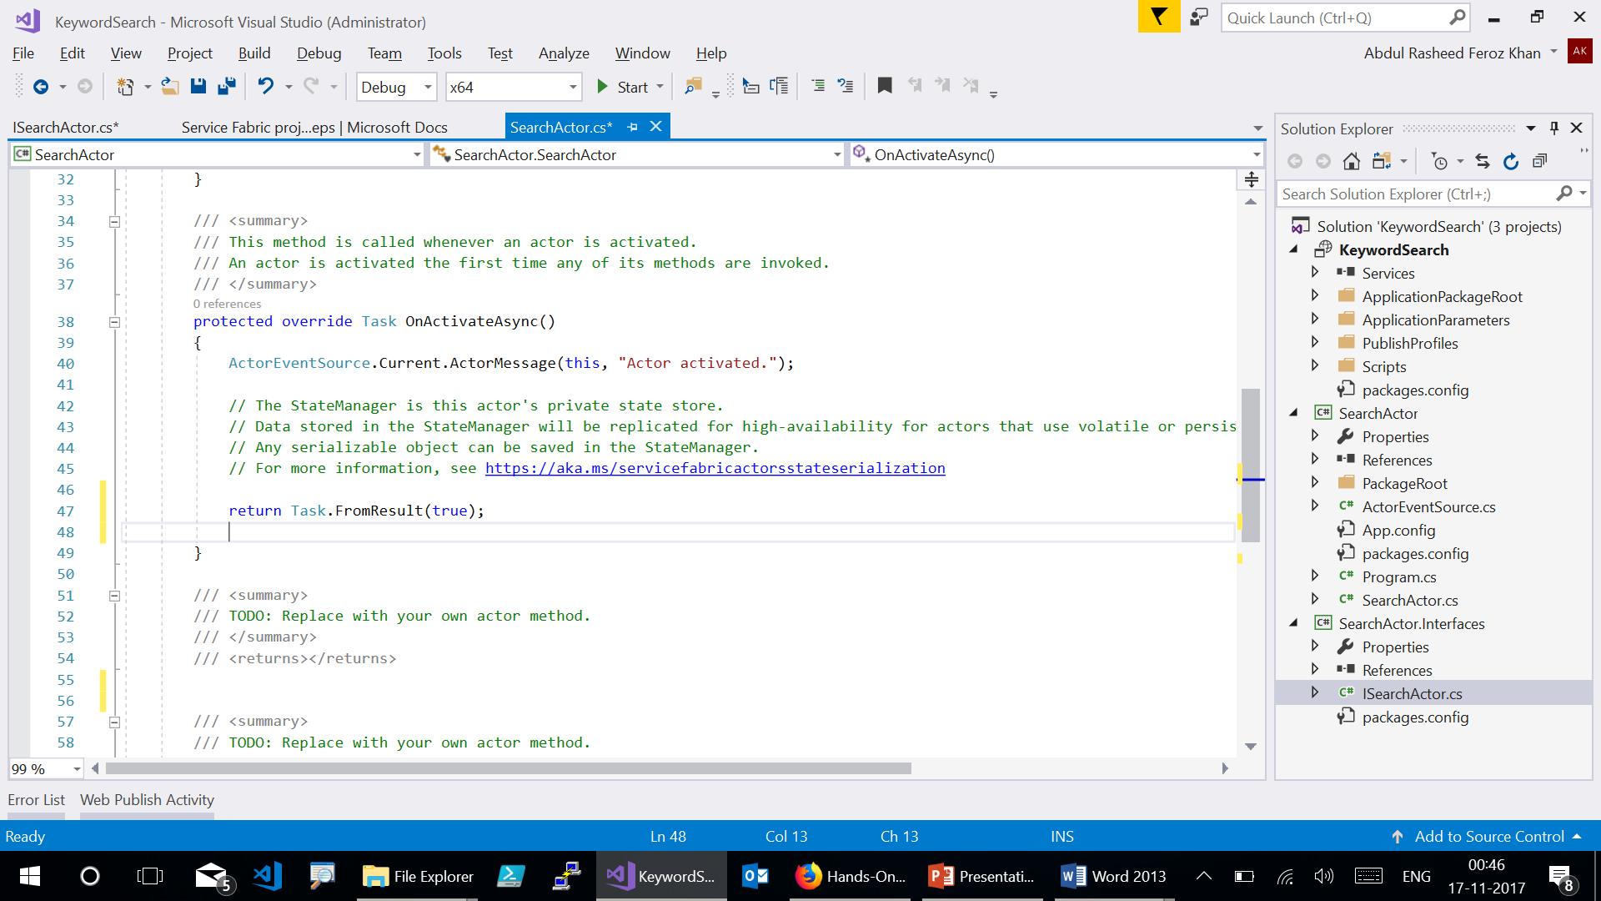

Slide 13
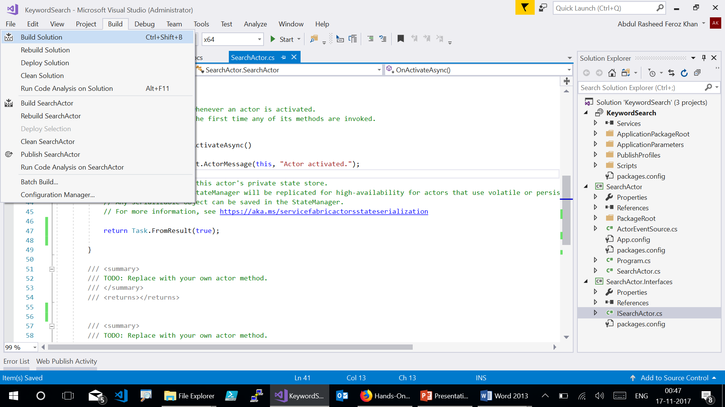

Slide 14
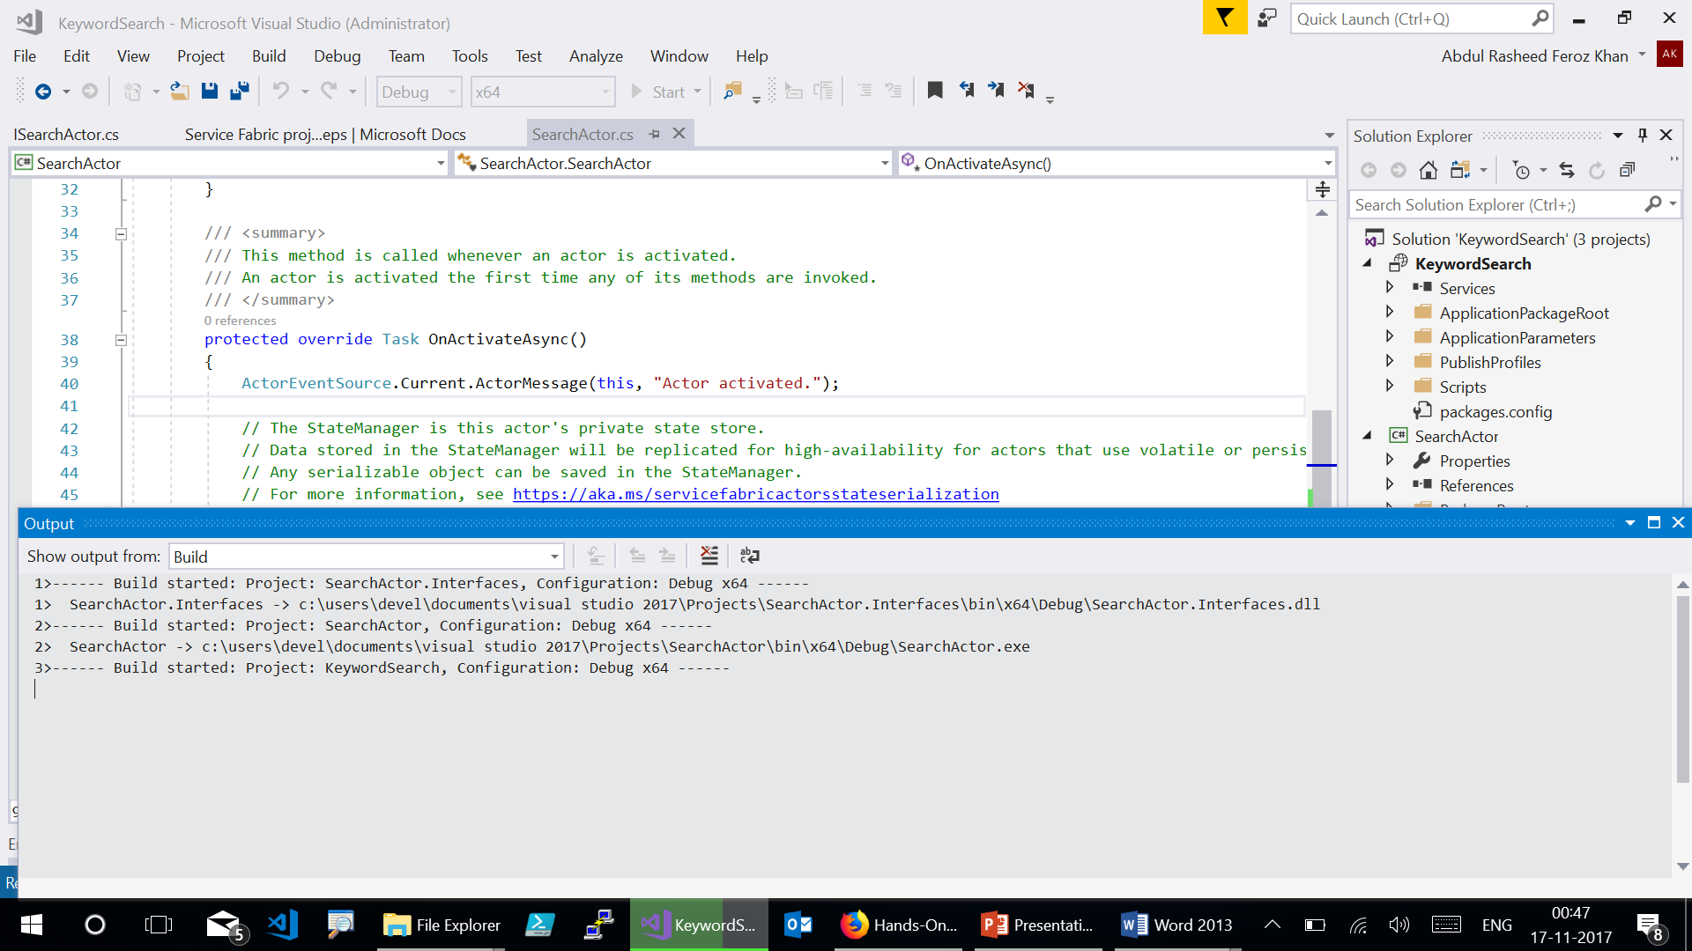

Slide 15
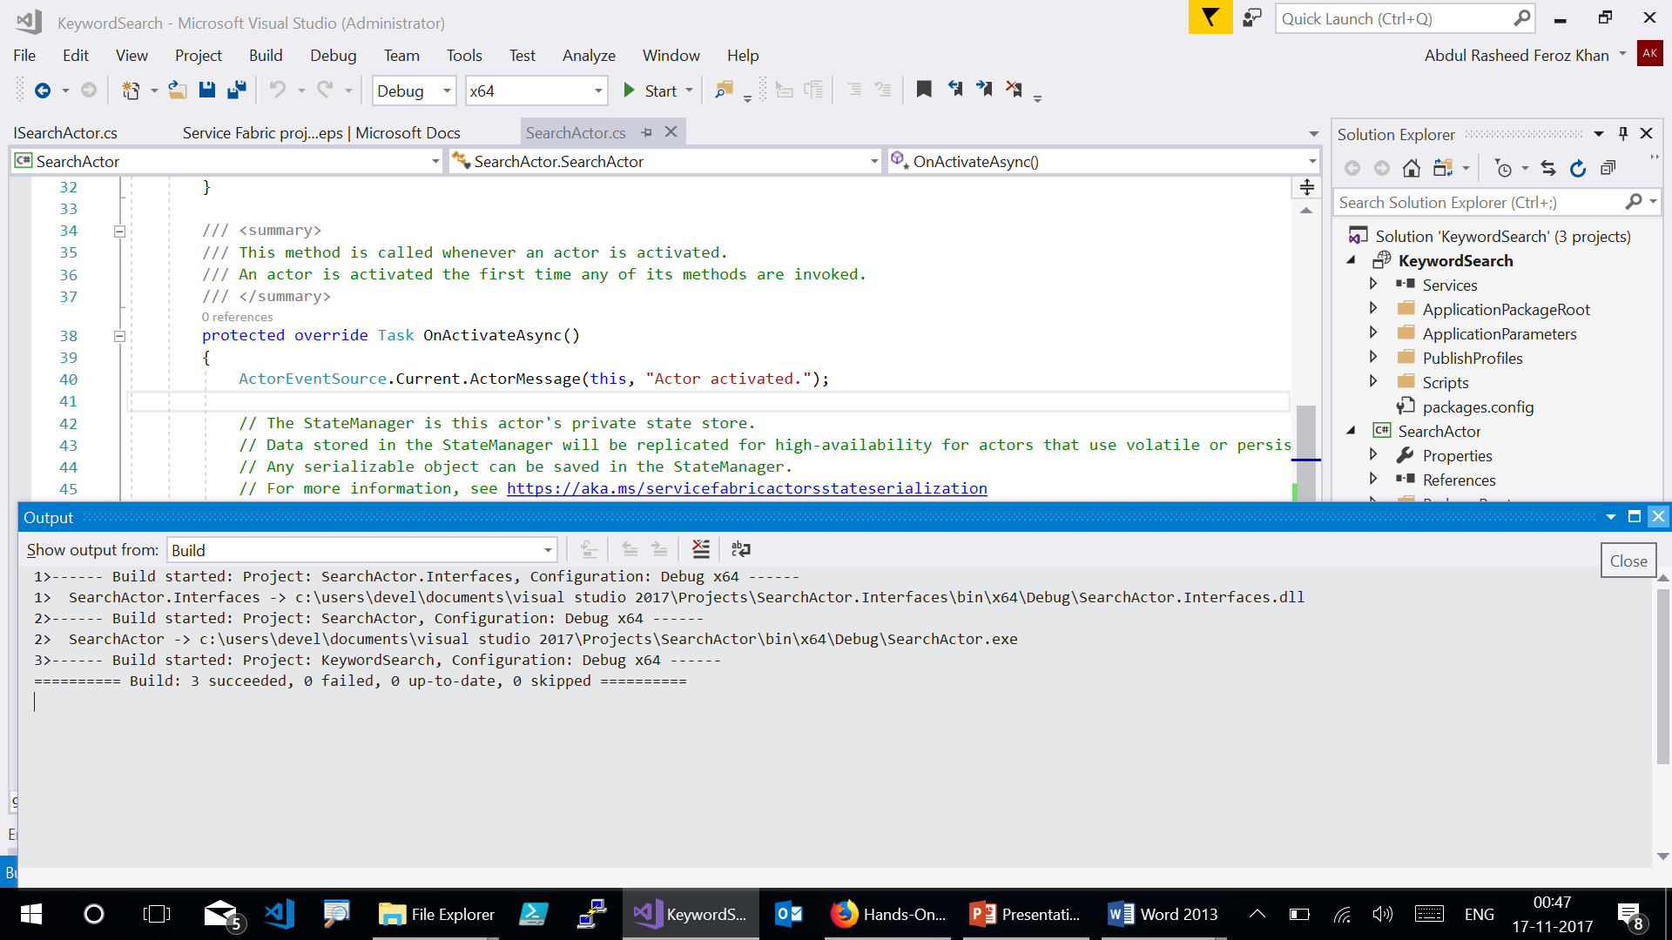

Slide 16
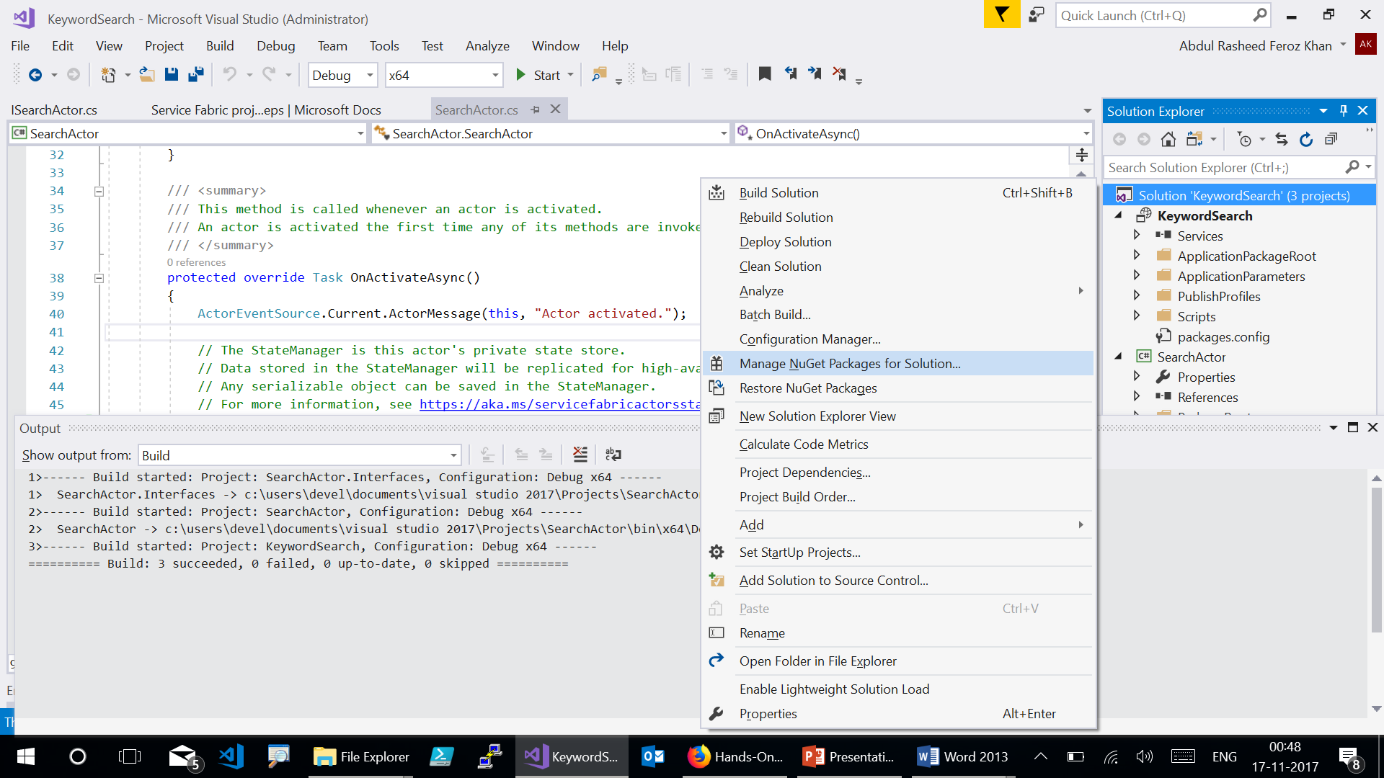

Slide 17
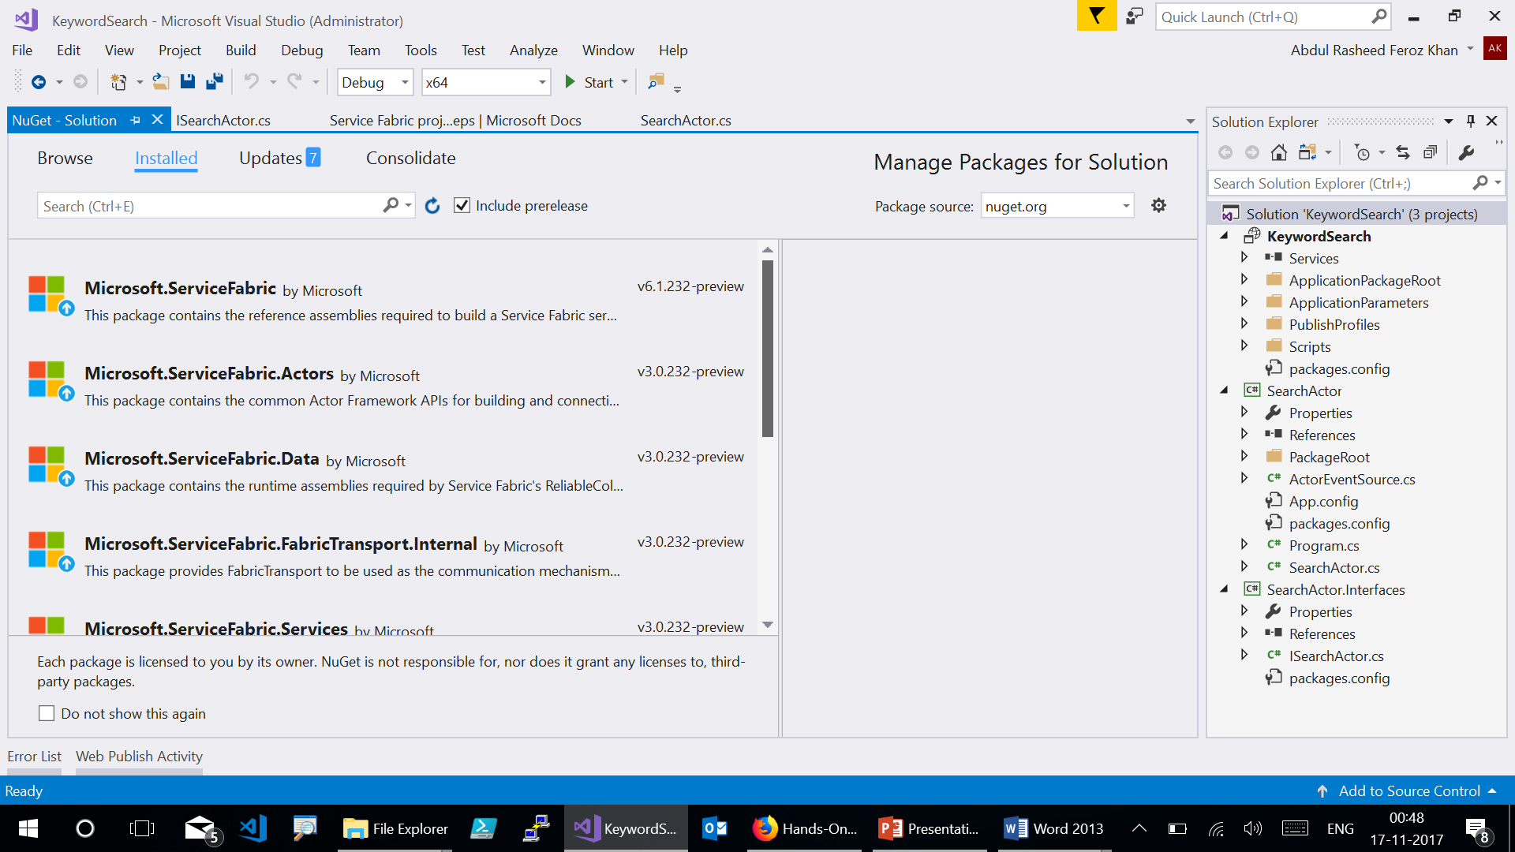
Notes:
· Microsoft.ServiceFabric: 5.6.220
· Microsoft.ServiceFabric.Acrors: 2.6.220
· Microsoft.ServiceFabric.Data: 2.6.220
· Microsoft.ServiceFabric.FabricTransport.Internal: 2.6.220
· Microsoft.ServiceFabric.Services: 2.6.220
· Microsoft.ServiceFabric.Services.Remoting: 2.6.220
· Microsoft.VisualStudio.Azure.Fabric.MSBuild: 1.6.0

Slide 18
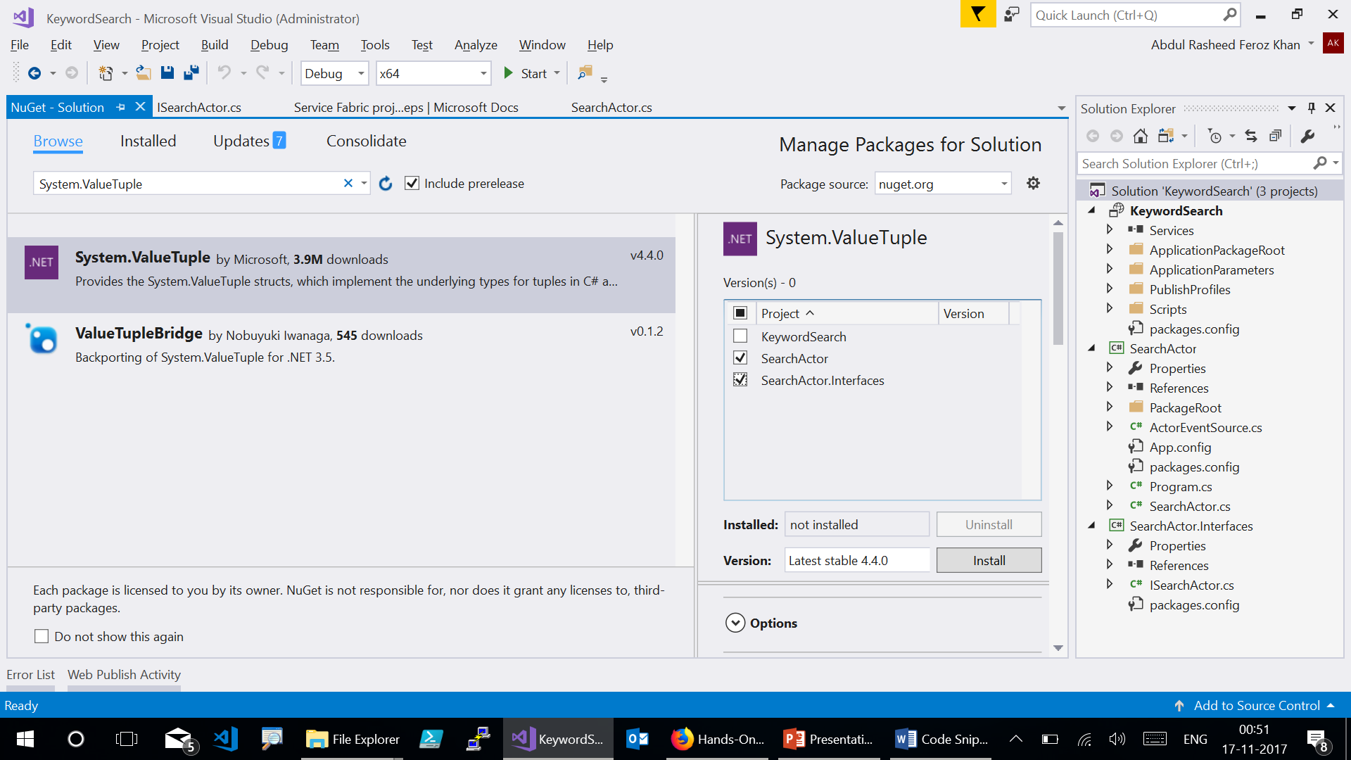
Notes:
Click on the Browse tab, then type System.ValueTuple in the search box and click the matching result. On the right side of the window, check the boxes next to SearchActor and SearchActor.Interfaces and then click Install. Accept any confirmation boxes that show up.

Slide 19
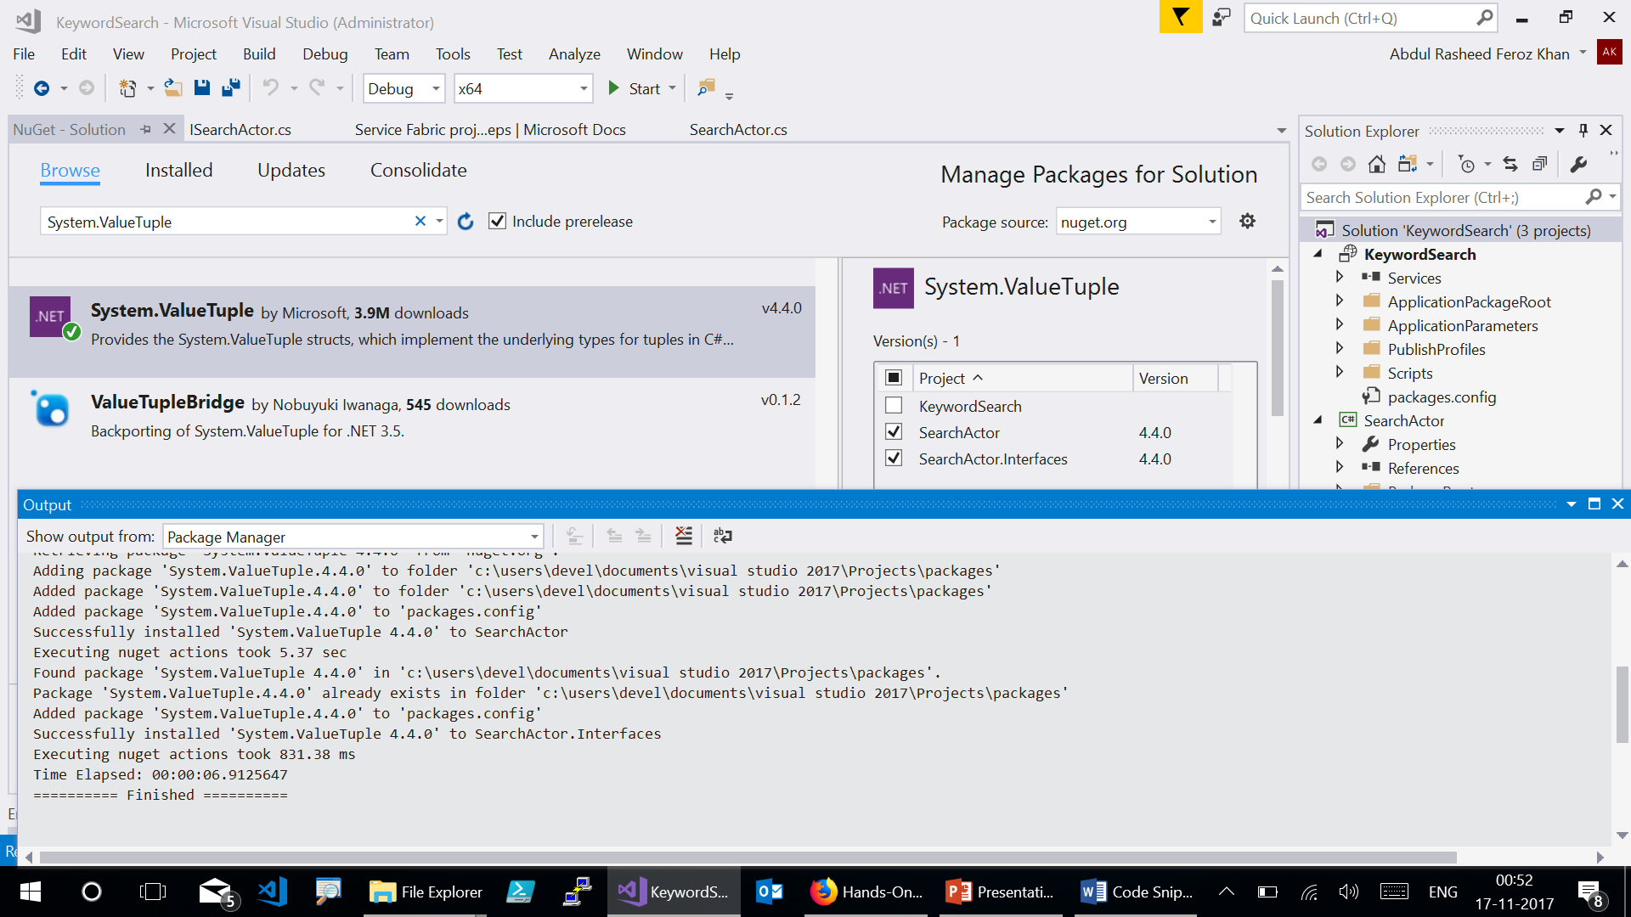

Slide 20
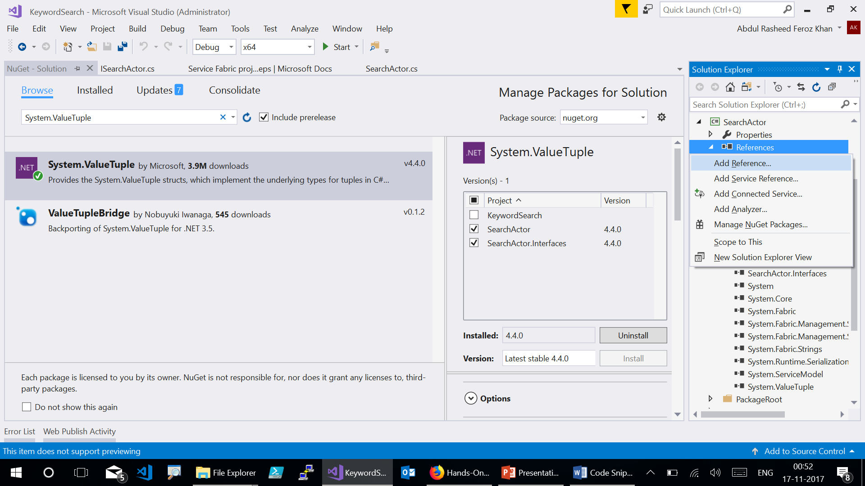

Slide 21
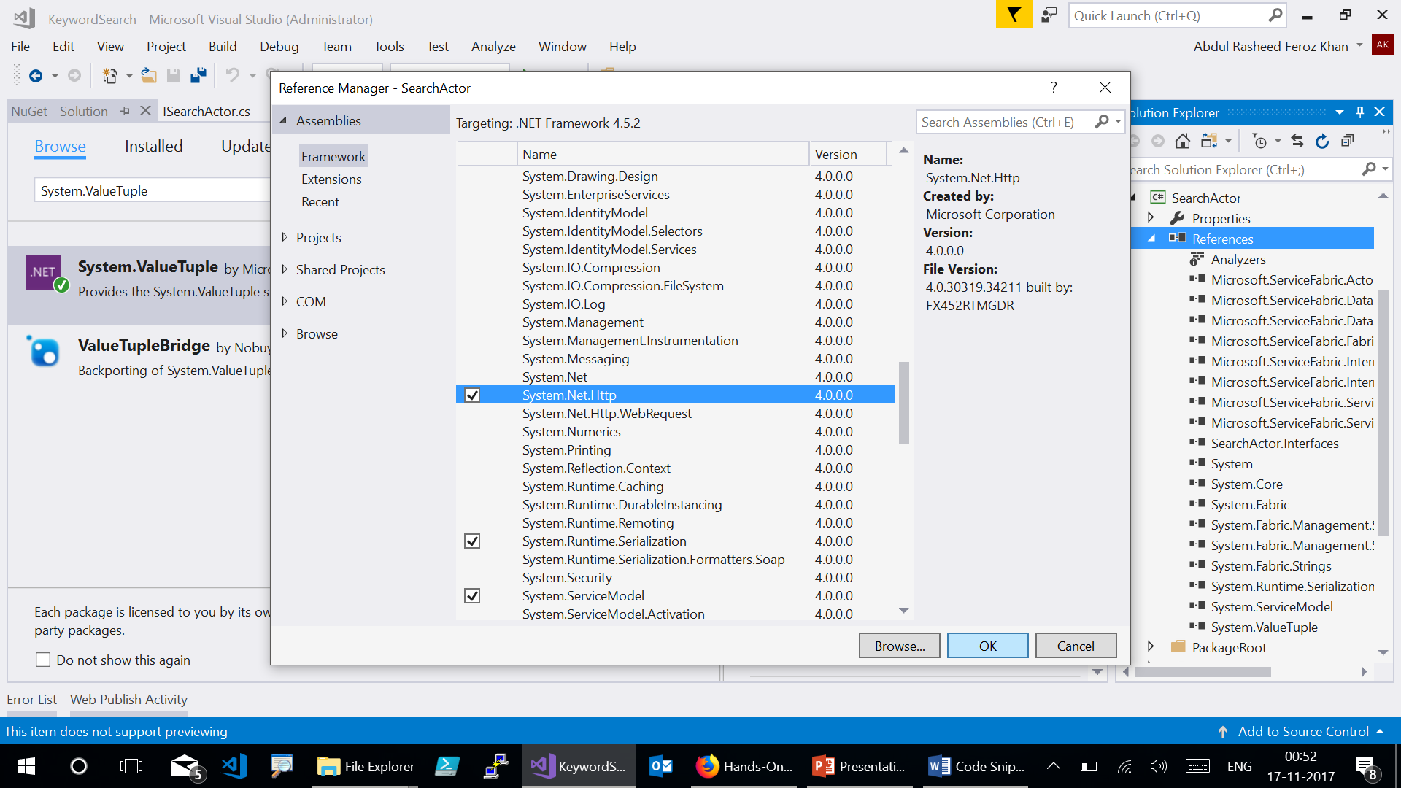
Notes:
Choose Assemblies -> Framework, then choose System.Net.Http and then click OK.

Slide 22
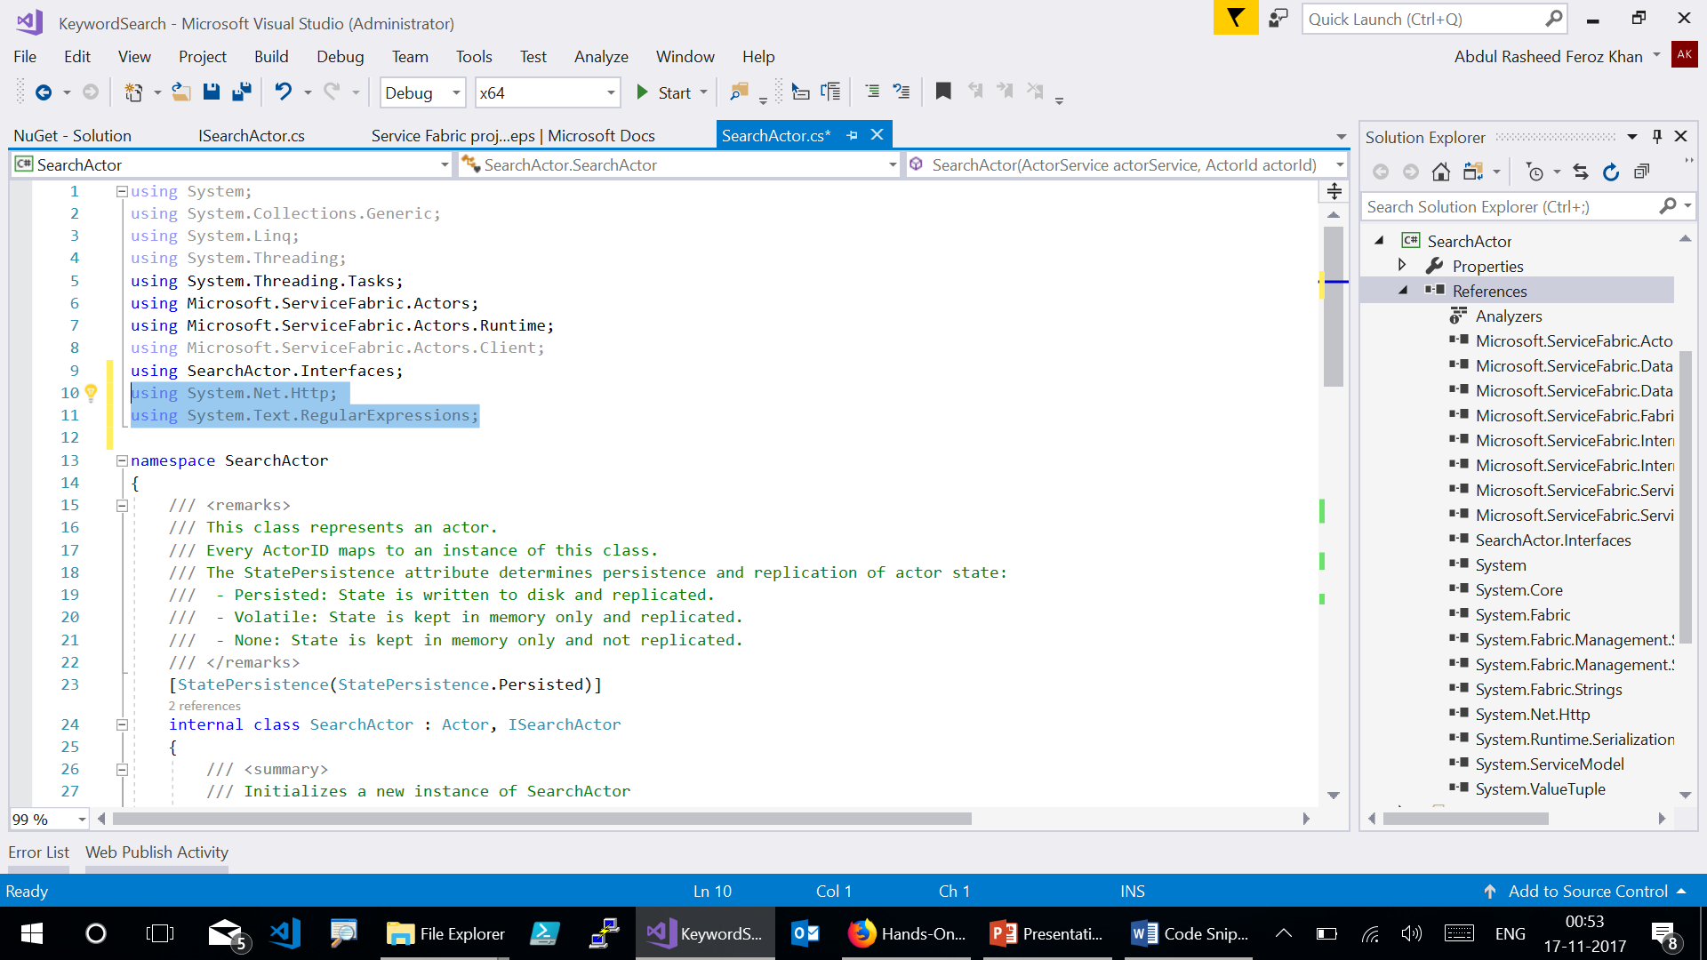
Notes:
using System.Net.Http;
using System.Text.RegularExpressions;

Slide 23
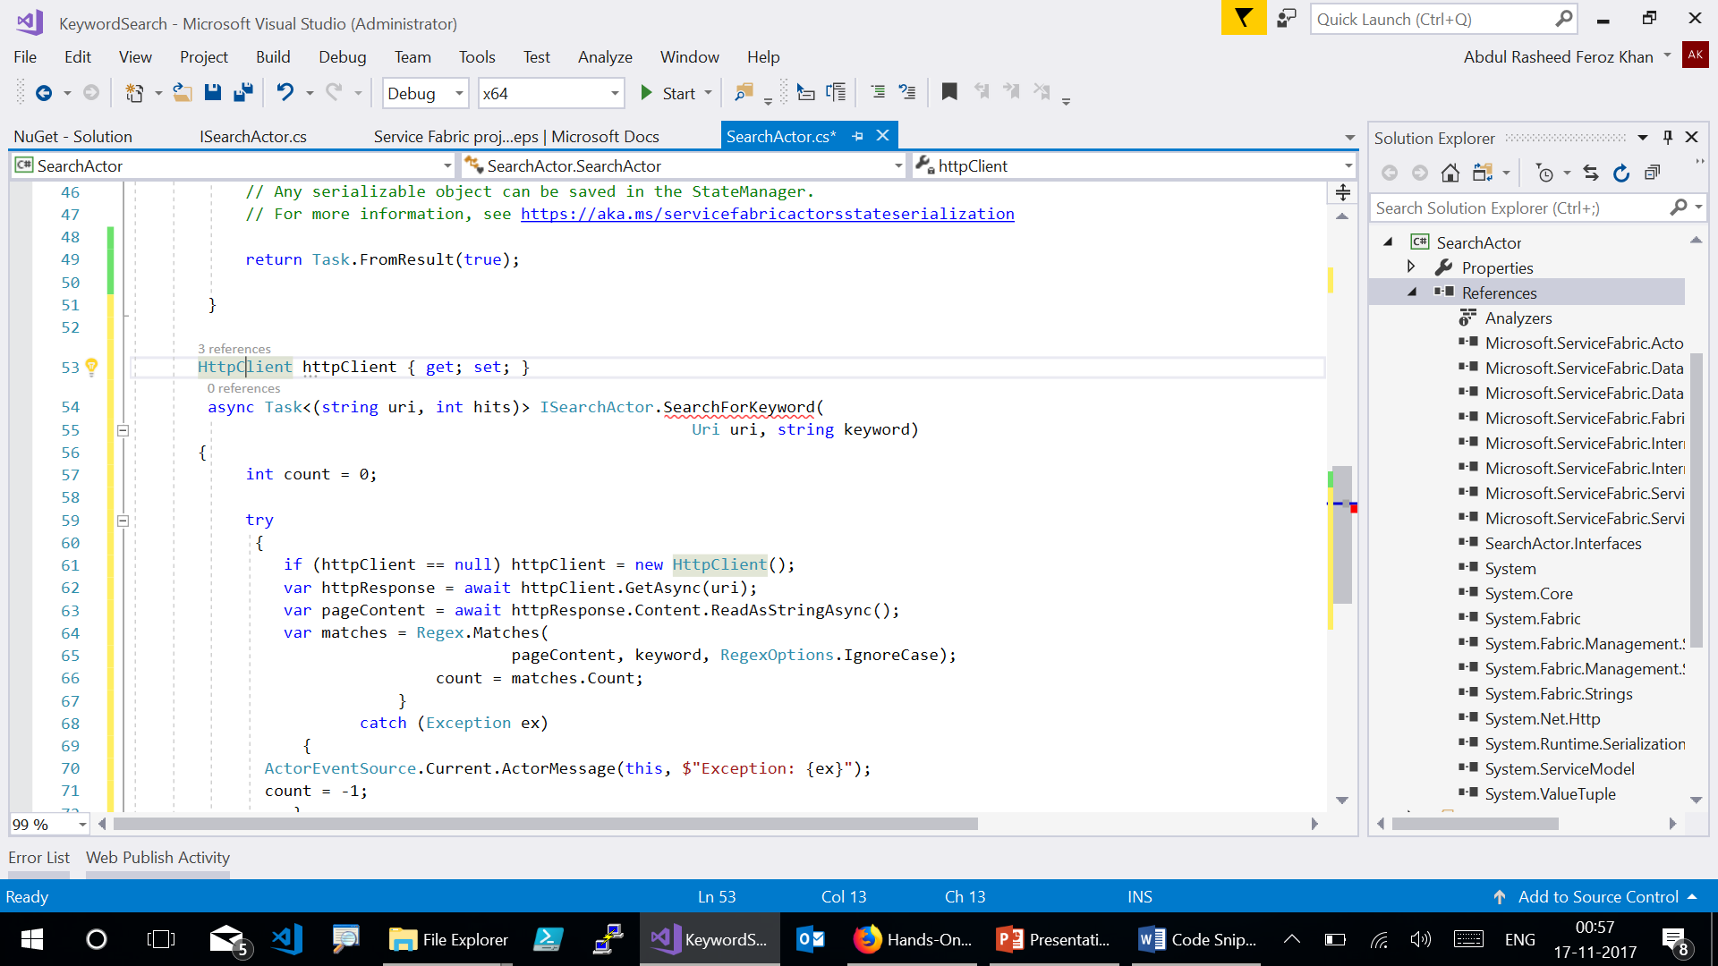
Notes:
At the bottom of the SearchActor class (beneath the “OnActivateAsync” method), add this new property and method. This code simply takes a Uri object and a string keyword. It then downloads the raw content of the page at that Uri and searches it for any occurrences of that keyword. It then returns the number of occurrences that it found along with the Uri it was searching. This is all the functionality that the search actor actually has. It exposes this method through its interface so that other services in the Service Fabric application can create and communicate with actor instances of this type. In this case, when an actor instance is created, the service that created it (and has a reference to it) can call this “SearchForKeyword” method to get search results from a web page. (You will see some red squiggles under the method name until the next step, that is ok)

Slide 24
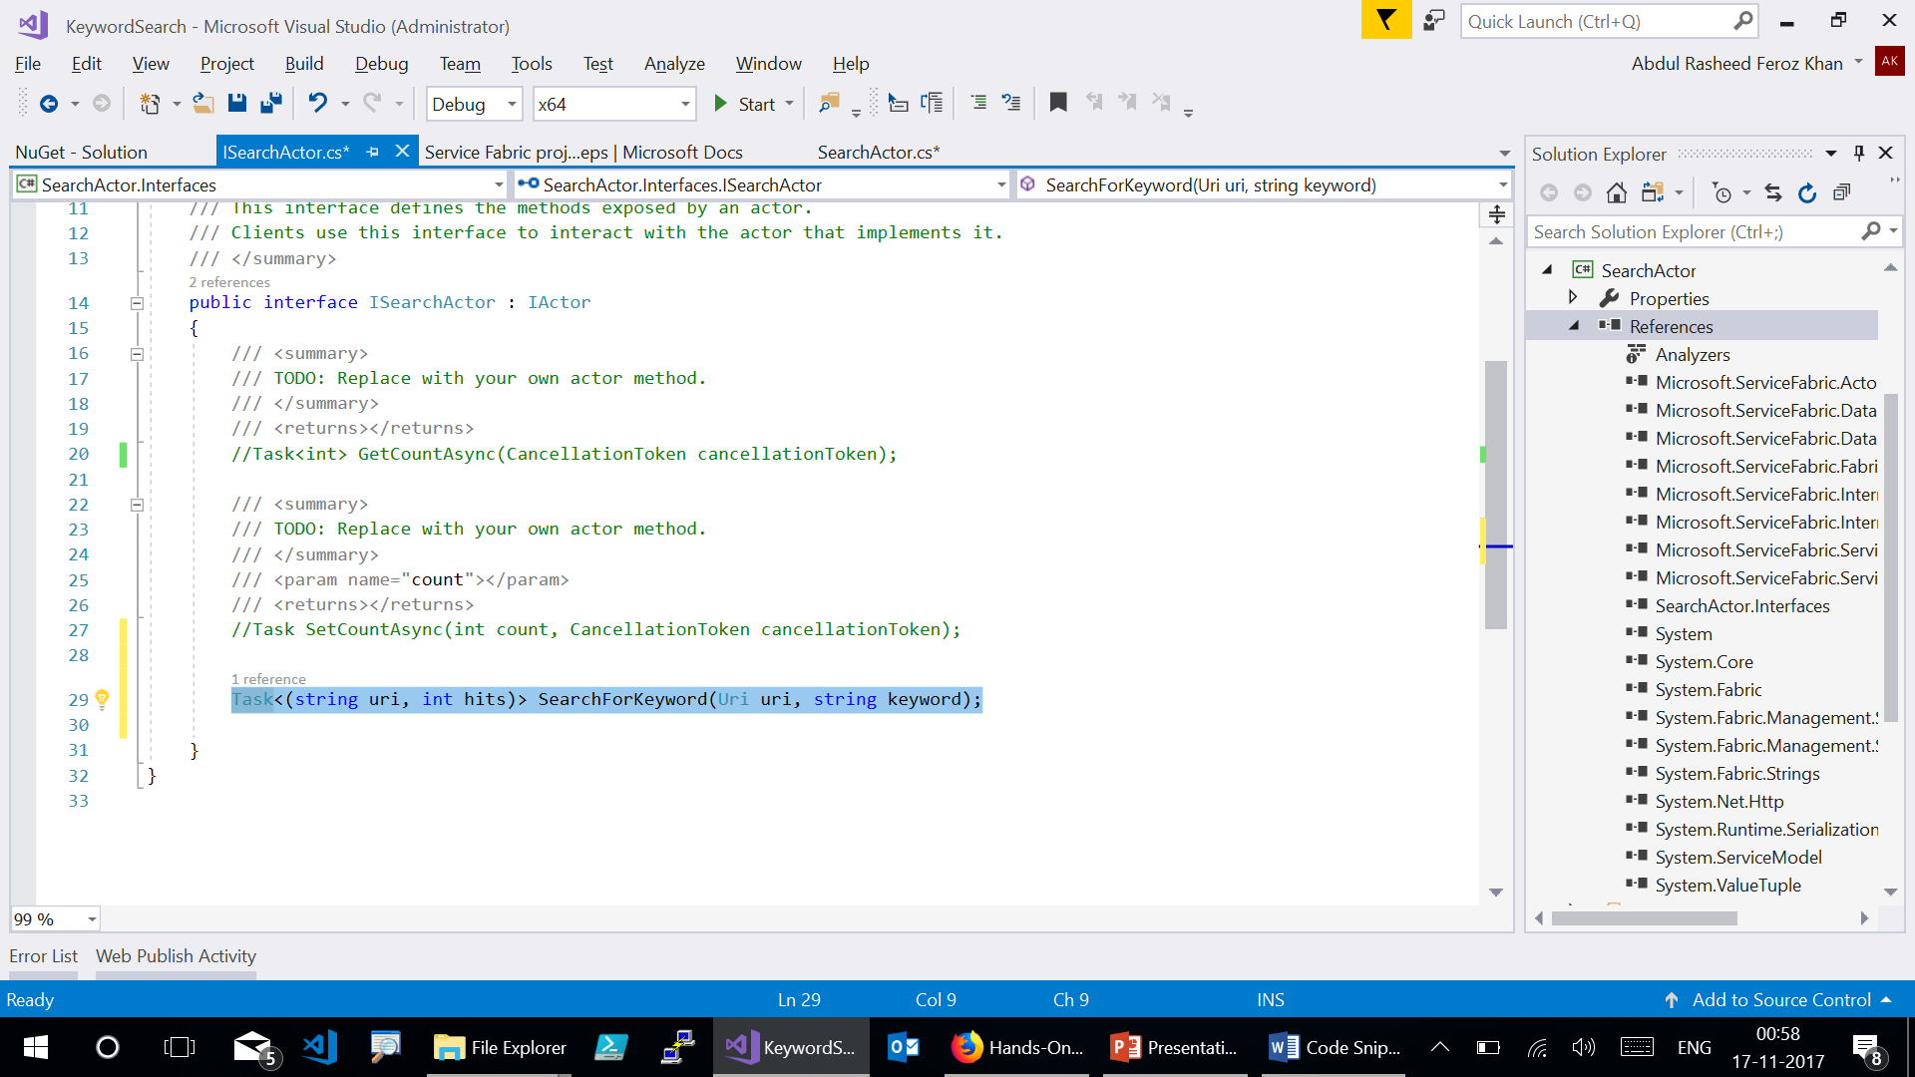
Notes:
Now, go to the ISearchActor.cs interface and add the signature for this new method.

Slide 25
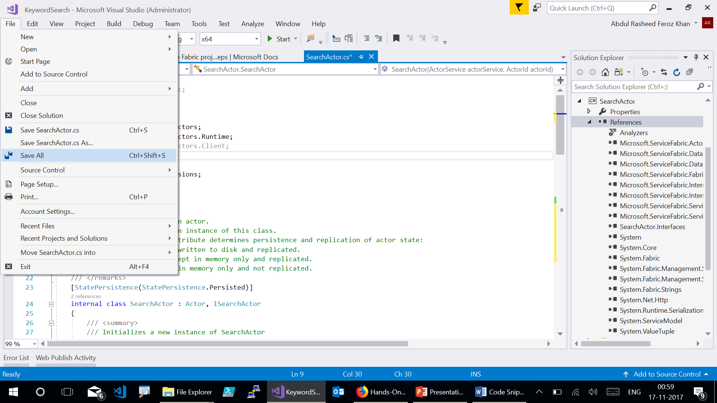

Slide 26
